Slide 1
Entity datasources

Slide 2
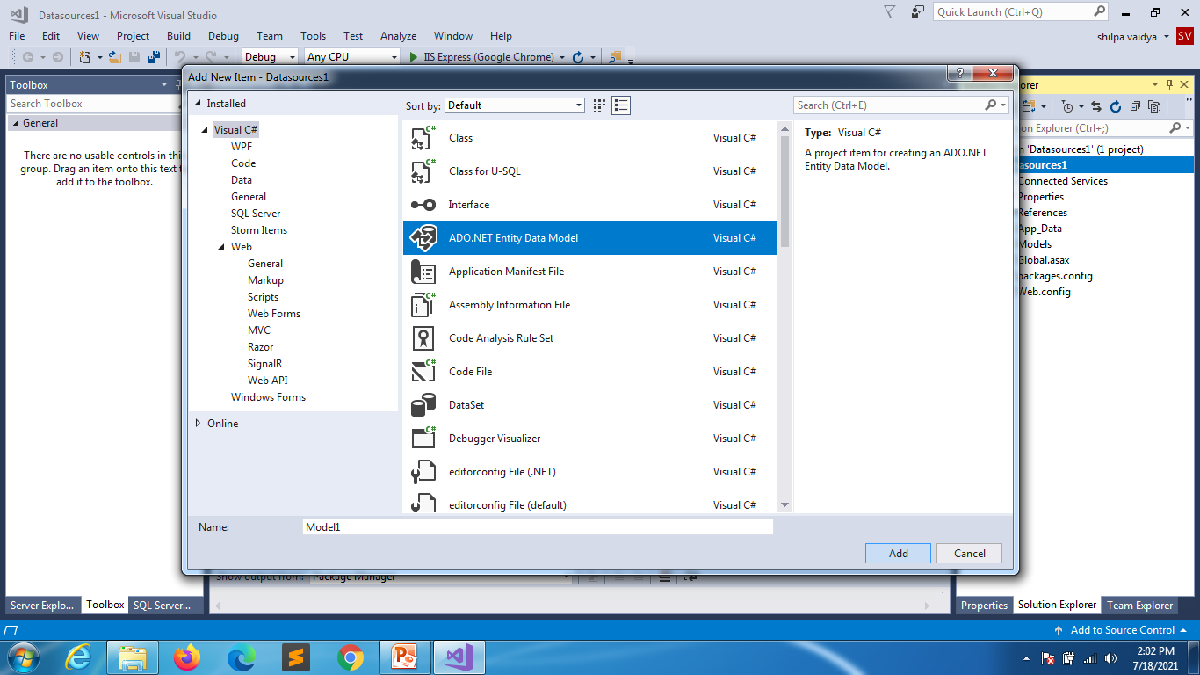

Slide 3
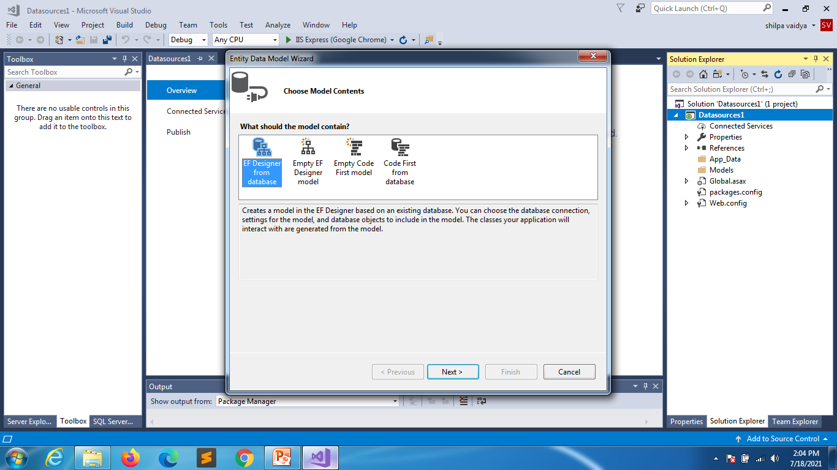

Slide 4
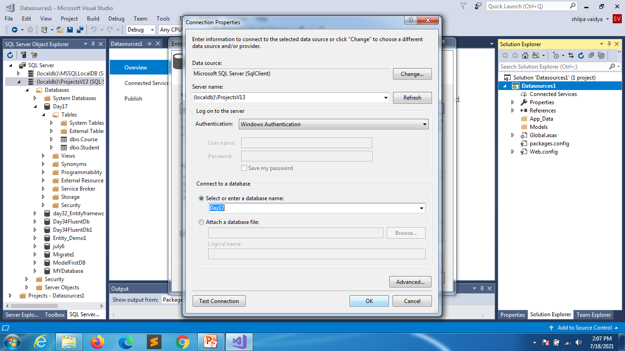

Slide 5
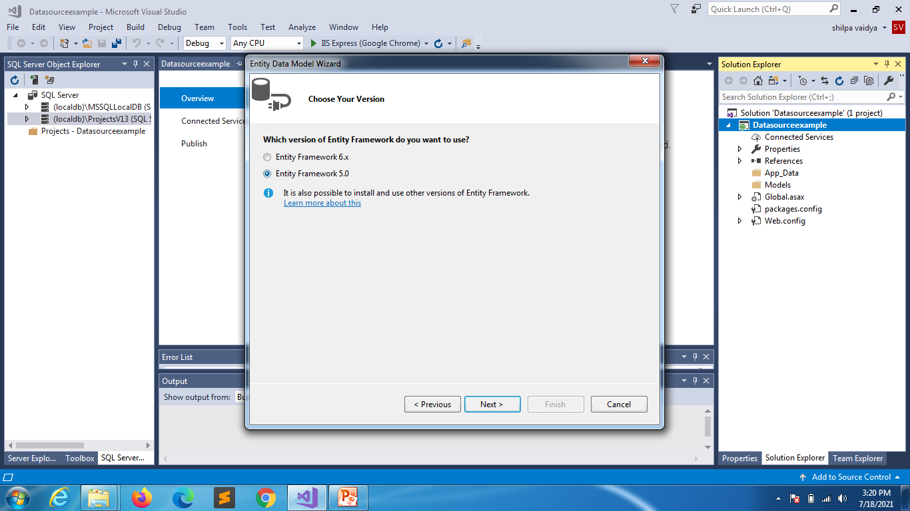

Slide 6
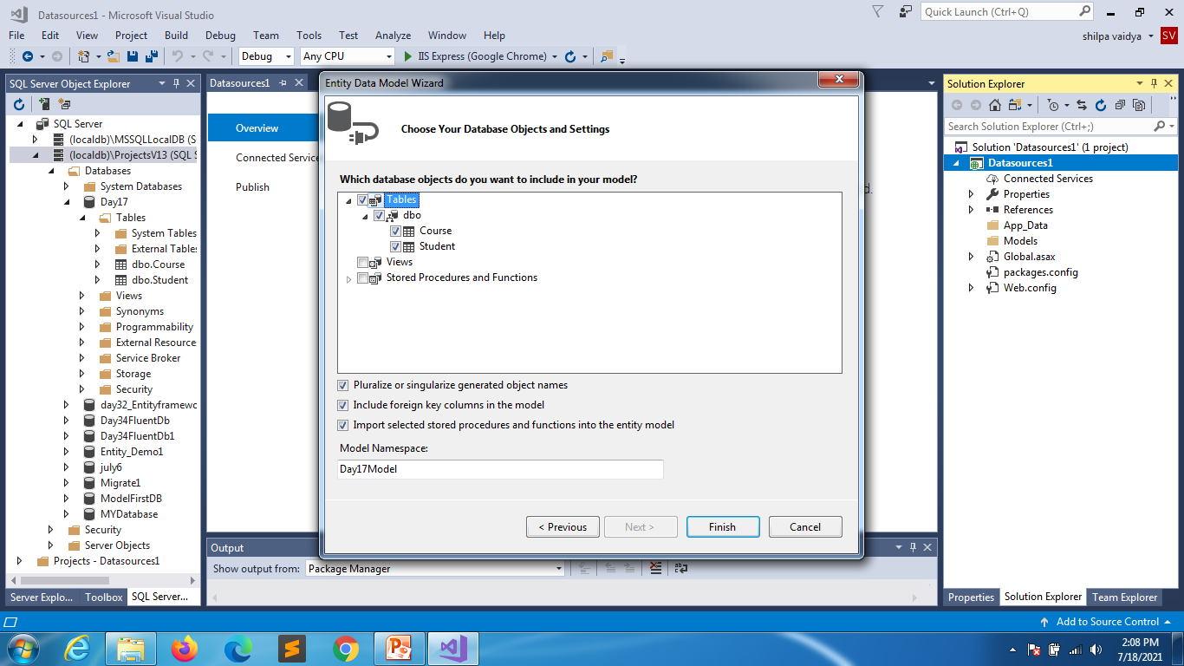

Slide 7
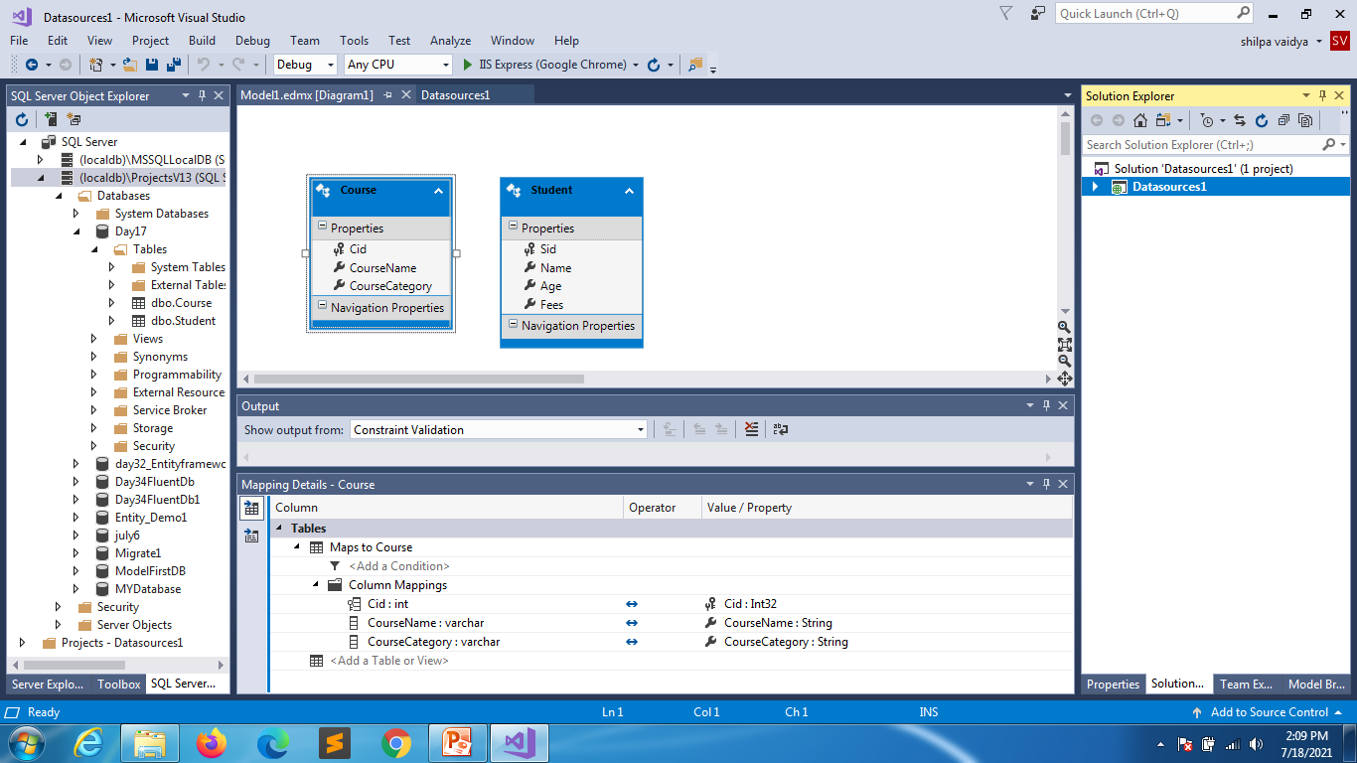

Slide 8
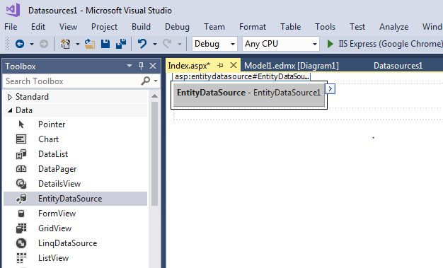
Add Index.aspx web form

Slide 9
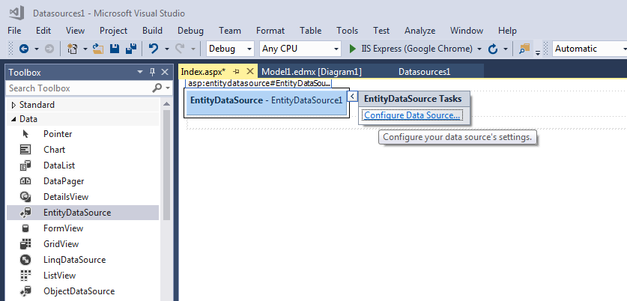

Slide 10
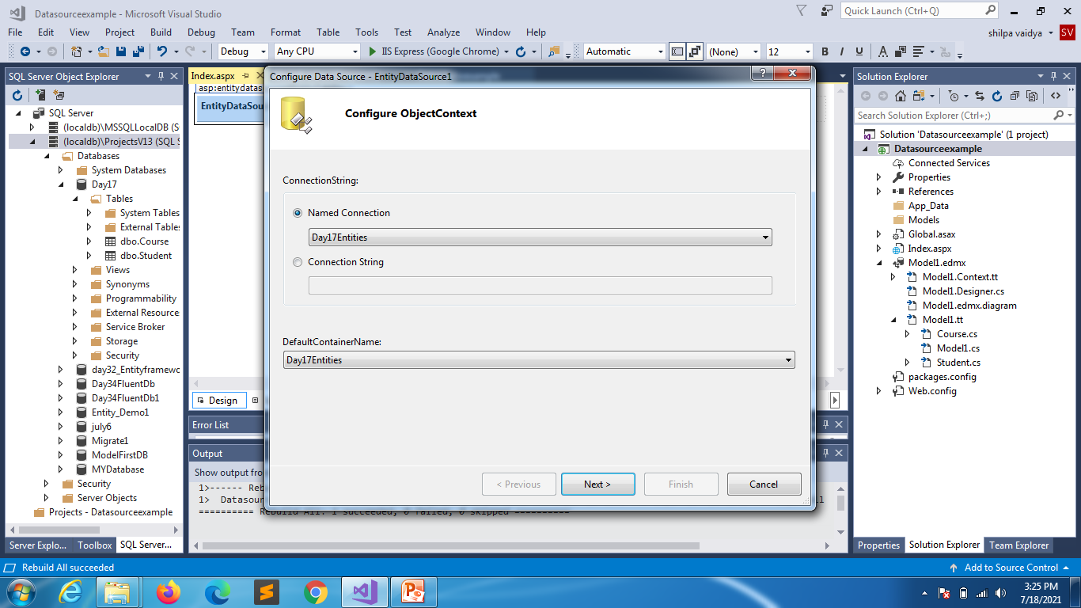

Slide 11
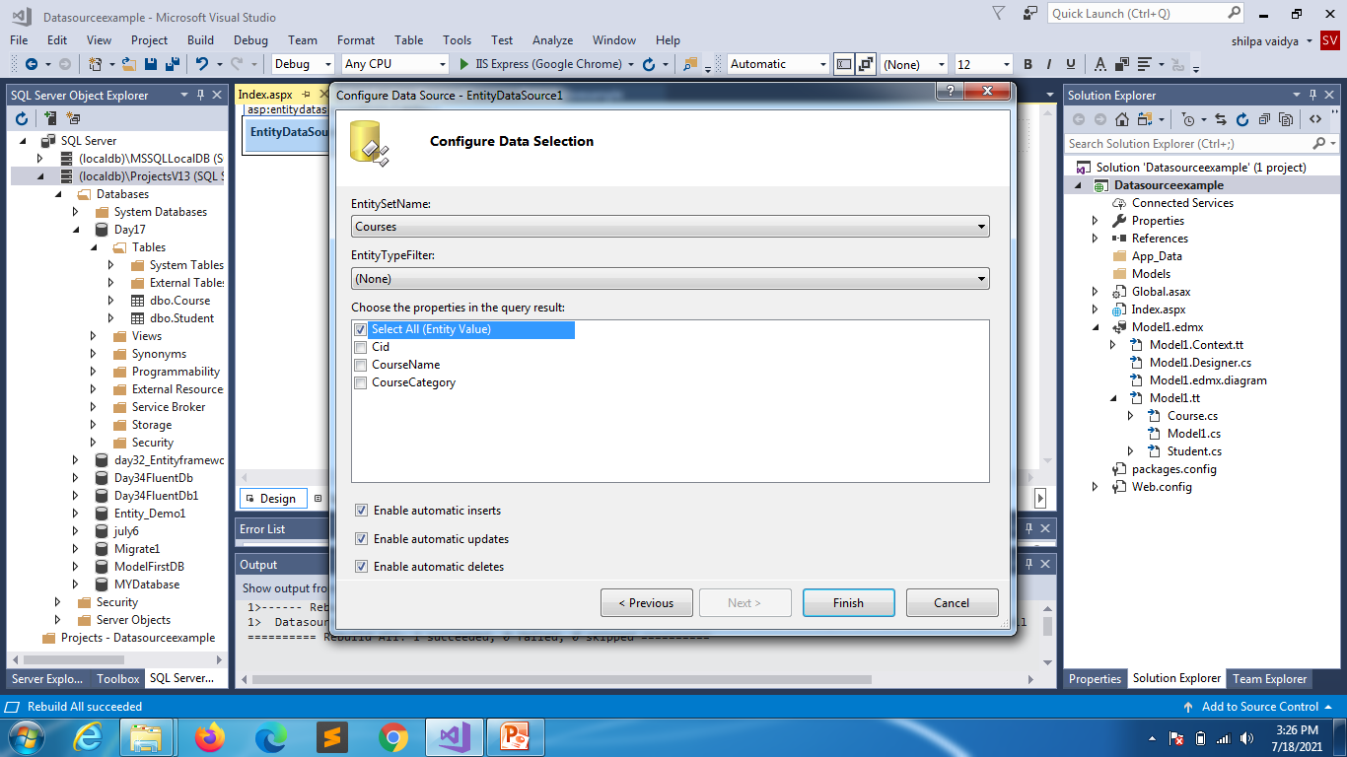

Slide 12
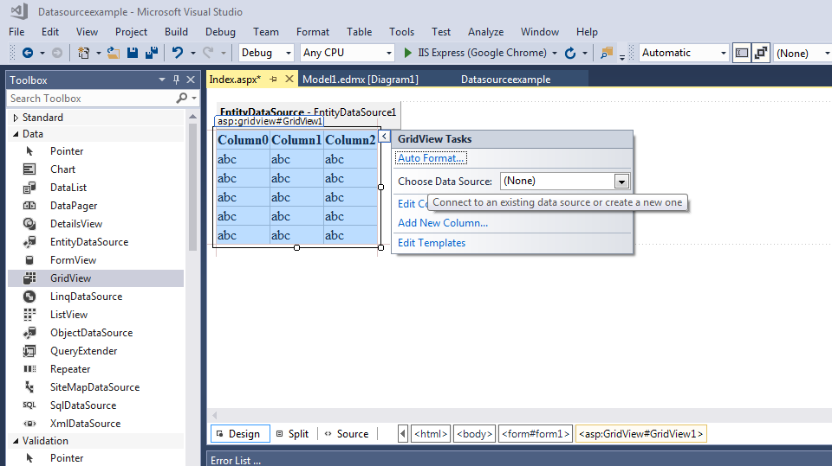
Drag and drop gridview

Slide 13
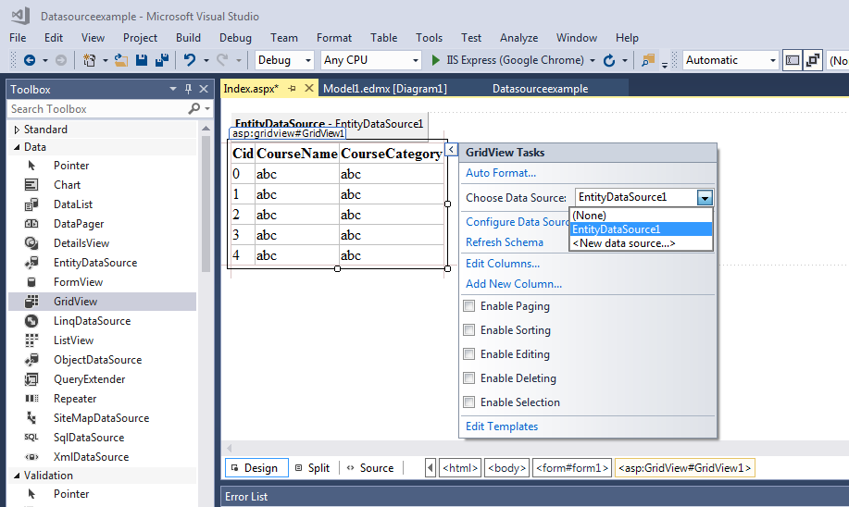

Slide 14
LINQ

Slide 15
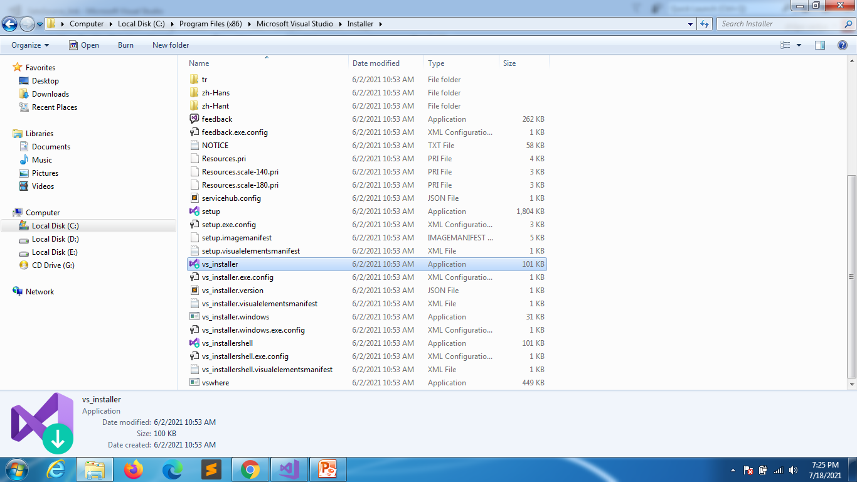
Navigate to vsinstaller in C drive

Slide 16
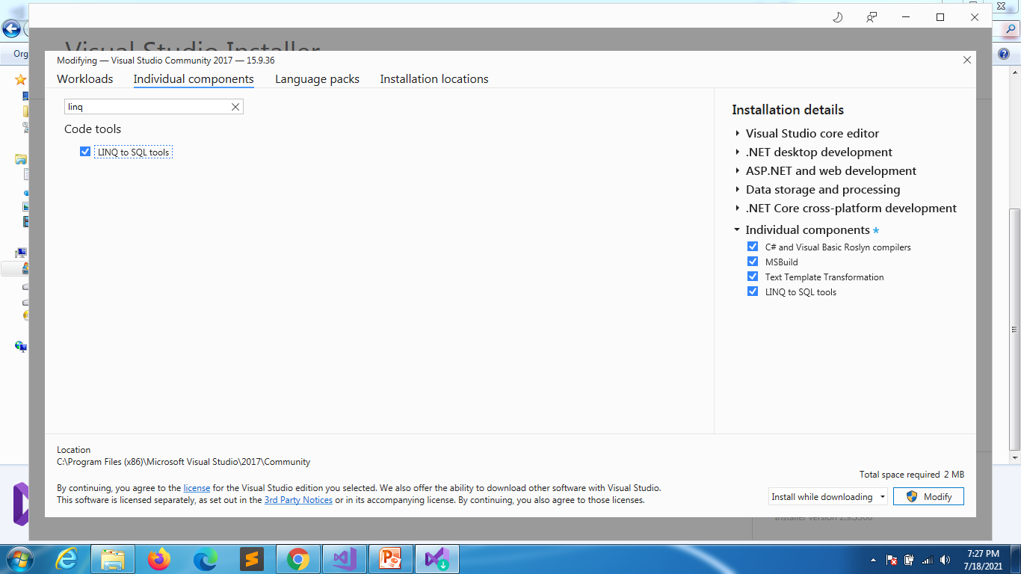
Click on modify
Click on
Individual components
Linq to SQL tools
& modify

Slide 17
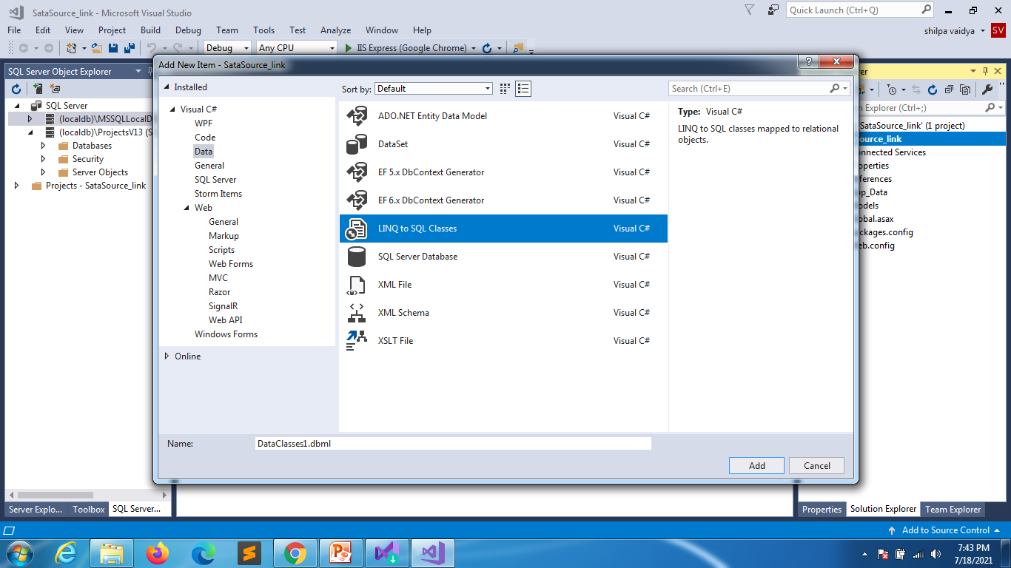

Slide 18
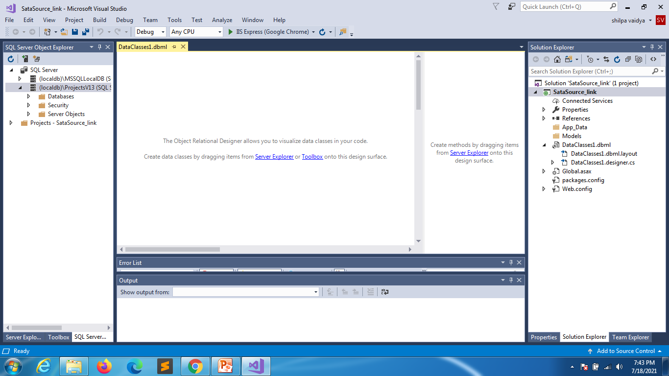
Click on server explorer

Slide 19
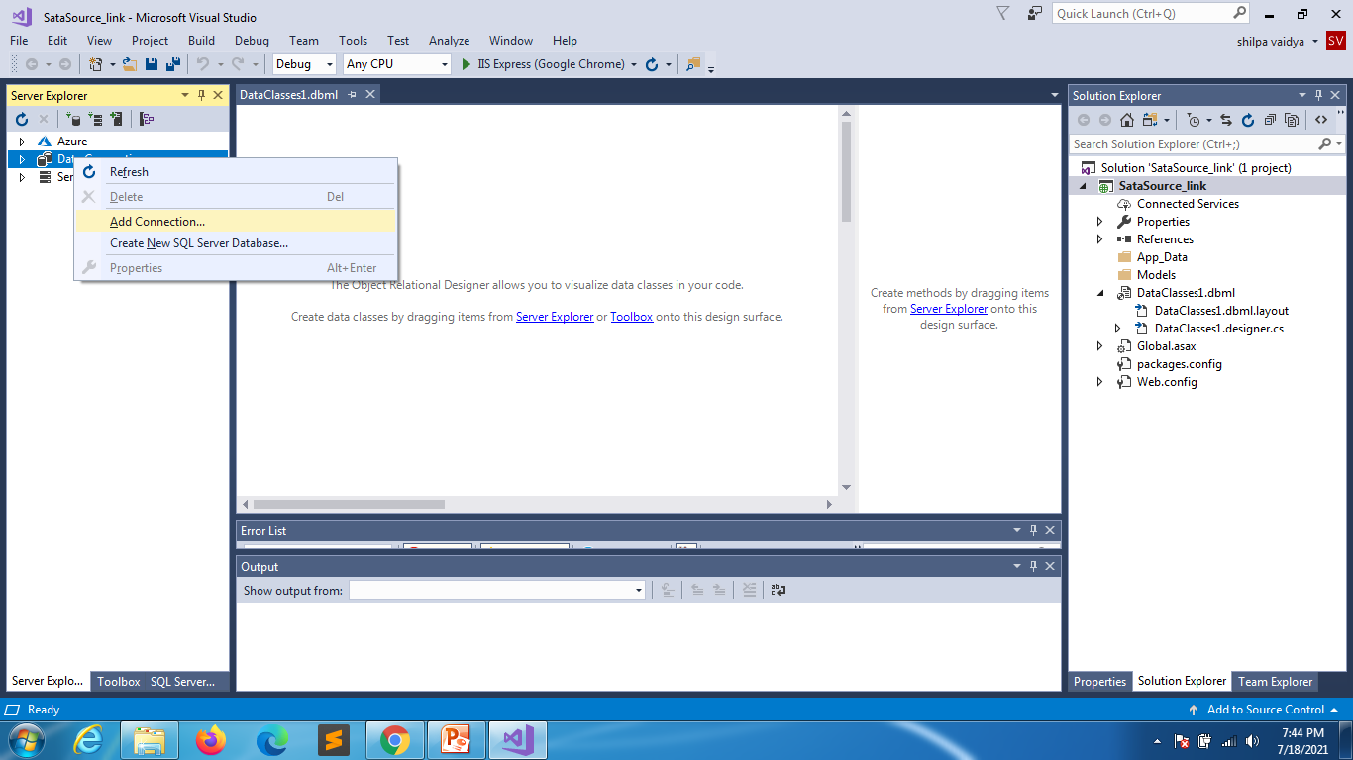

Slide 20
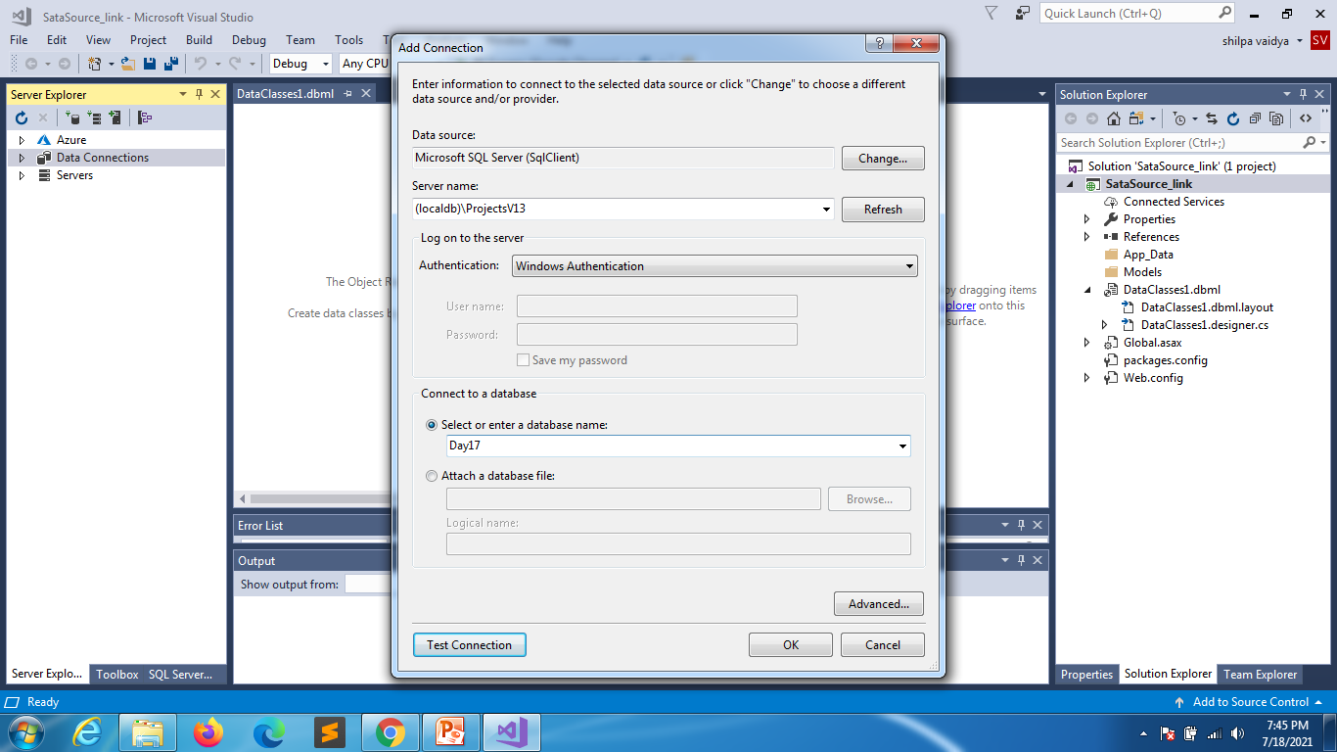

Slide 21
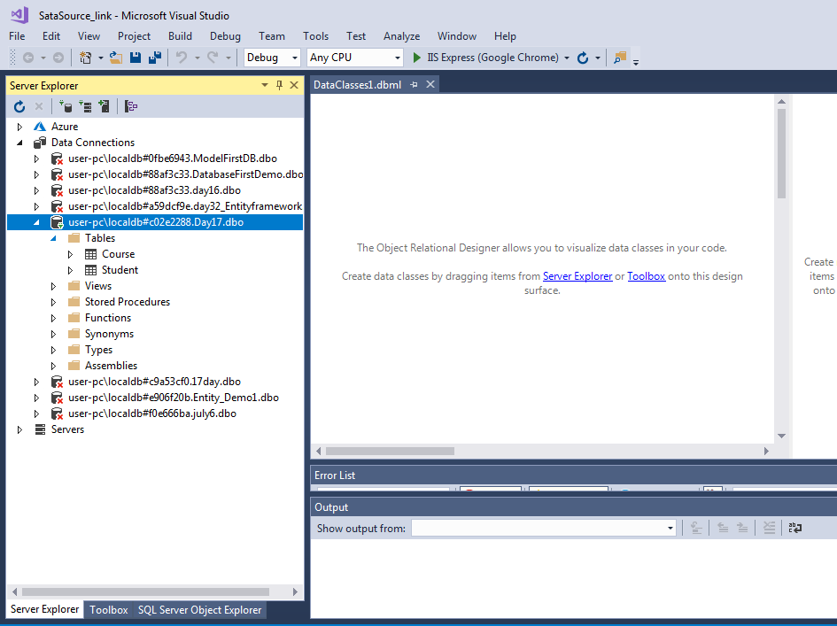

Slide 22
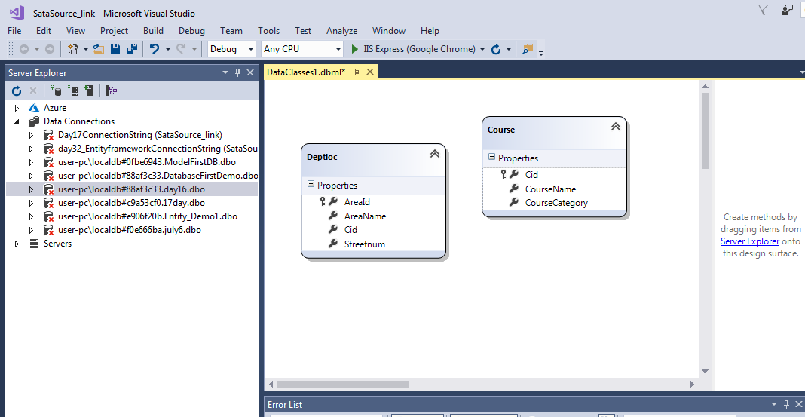
After you drag and drop save it
Drag and drop your tables

Slide 23
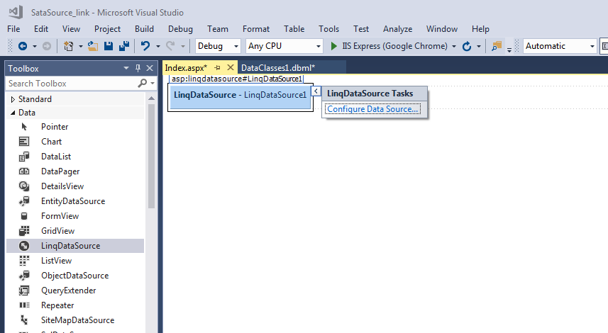
Index.aspx

Slide 24
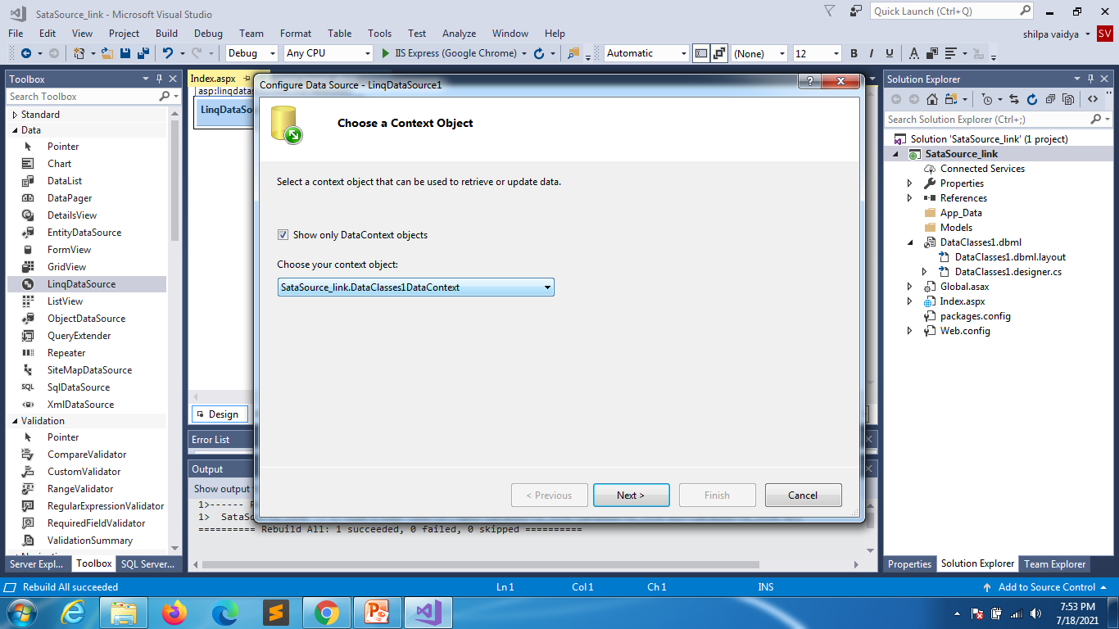
Build classes

Slide 25
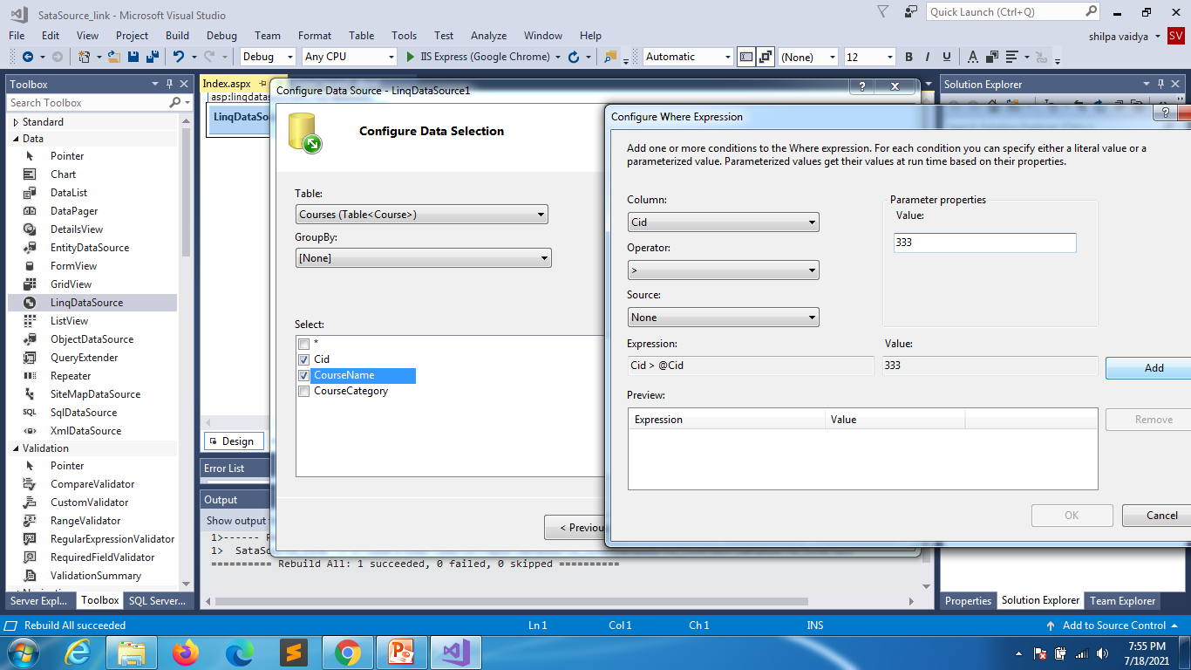
Click on where clause
111

Slide 26
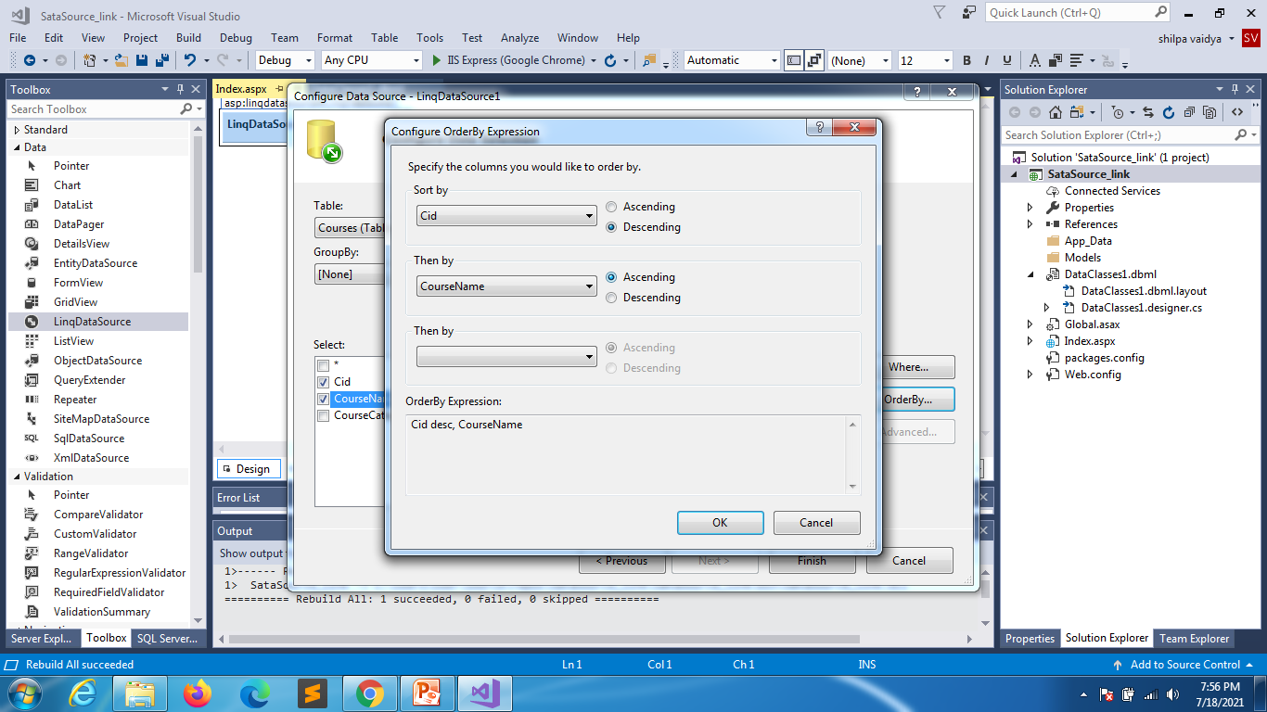
Order
Click ok and finish after selection

Slide 27
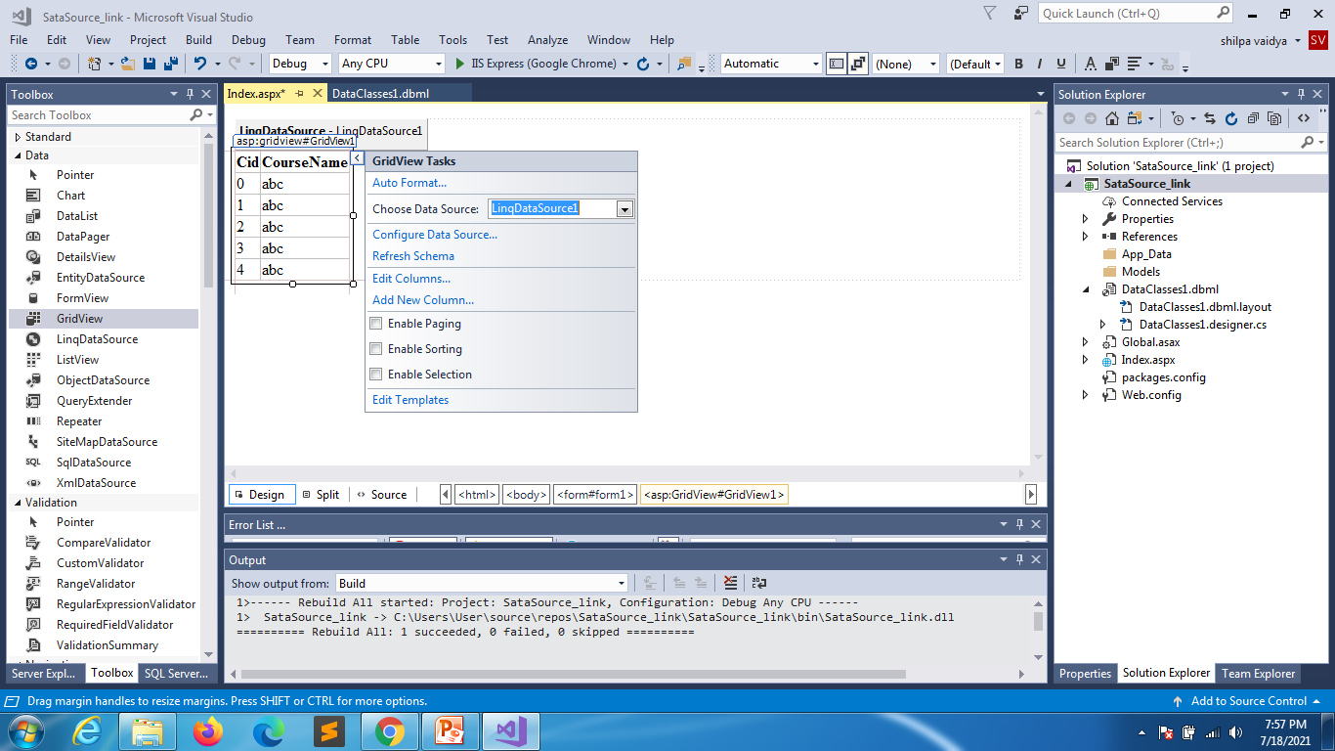
Drag and drop gridview

Slide 28
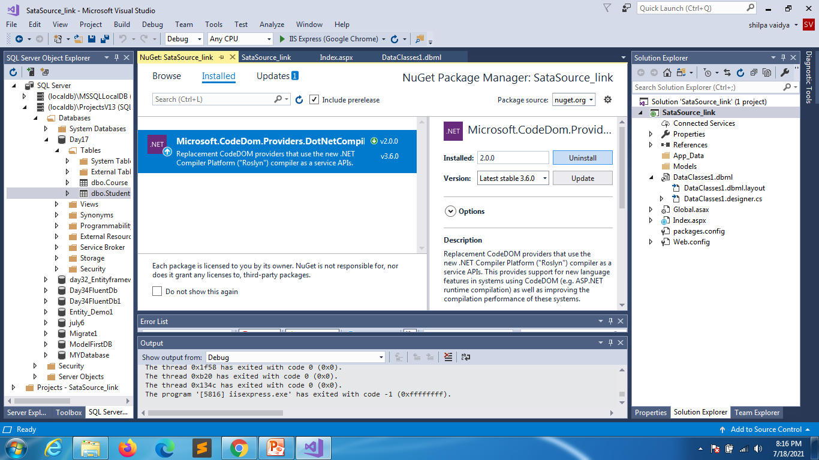
Uninstall the below package

Slide 29
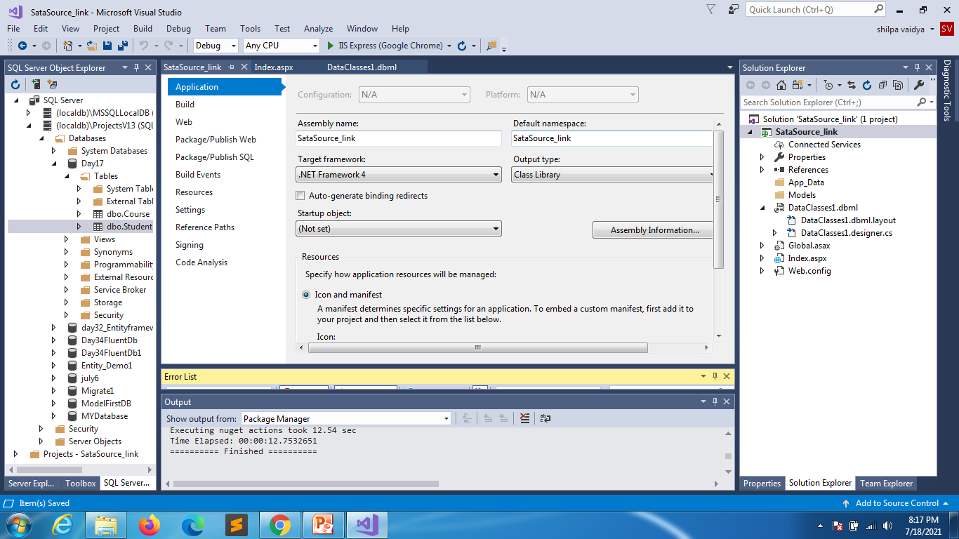

Slide 30
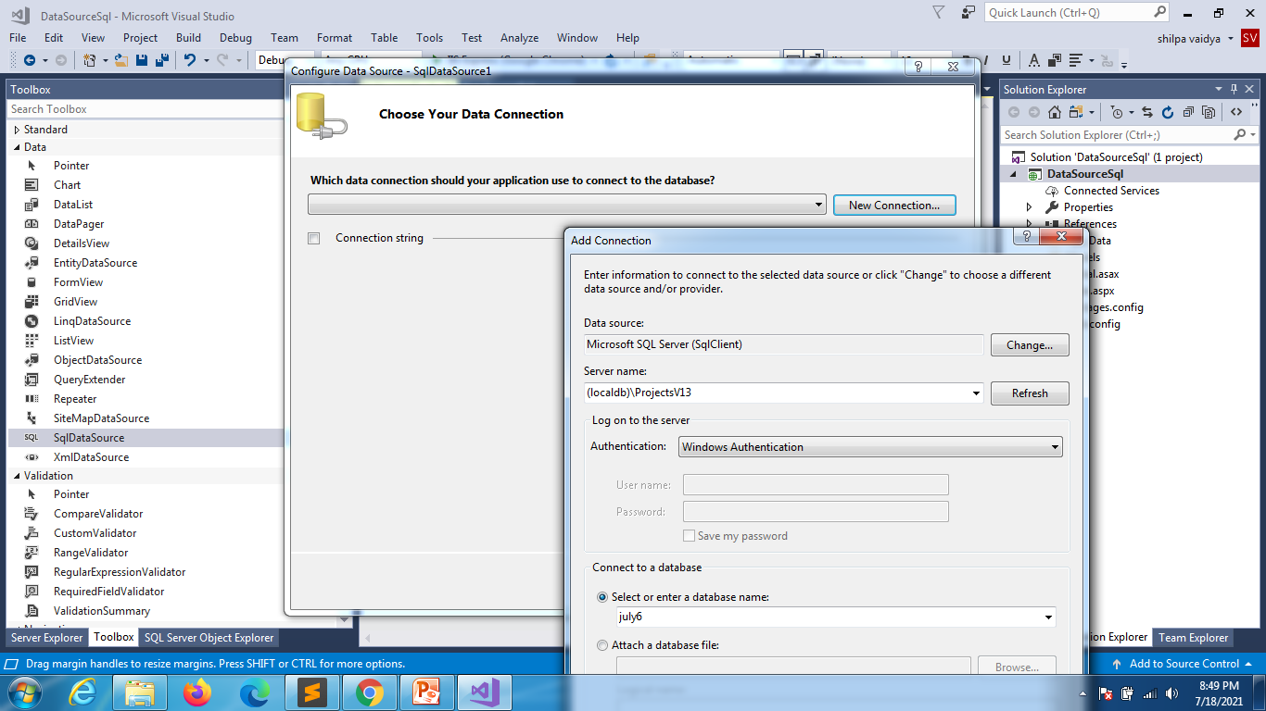
SQL datasource

Slide 31
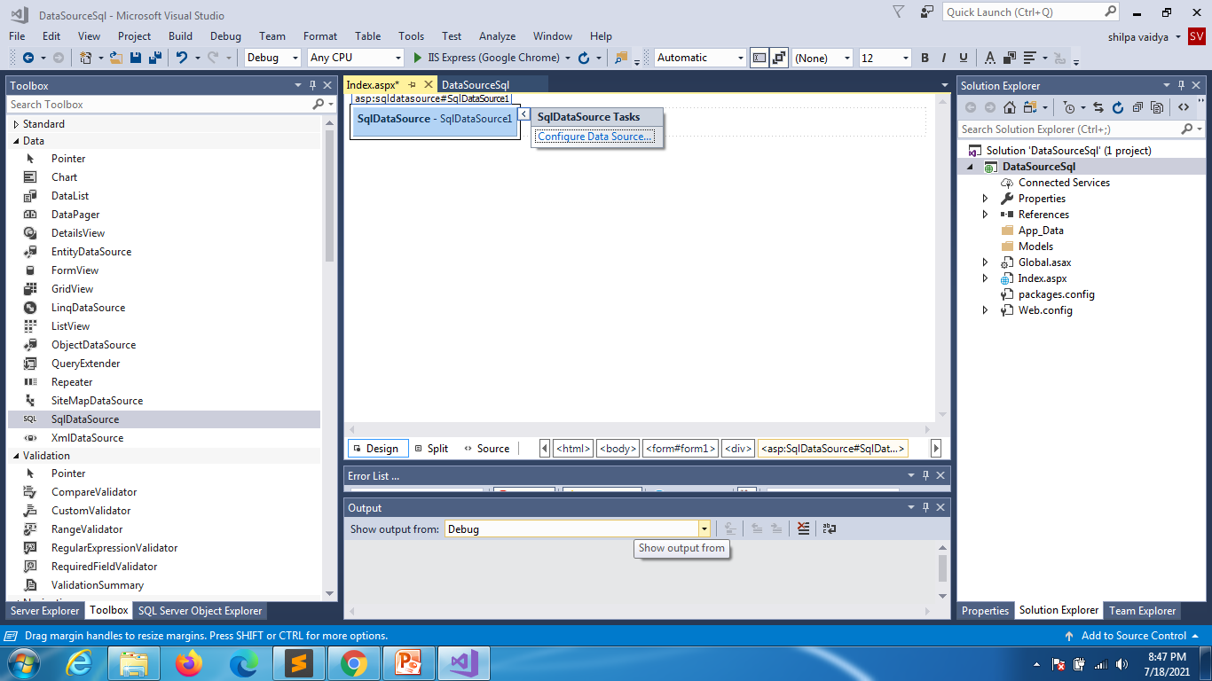

Slide 32
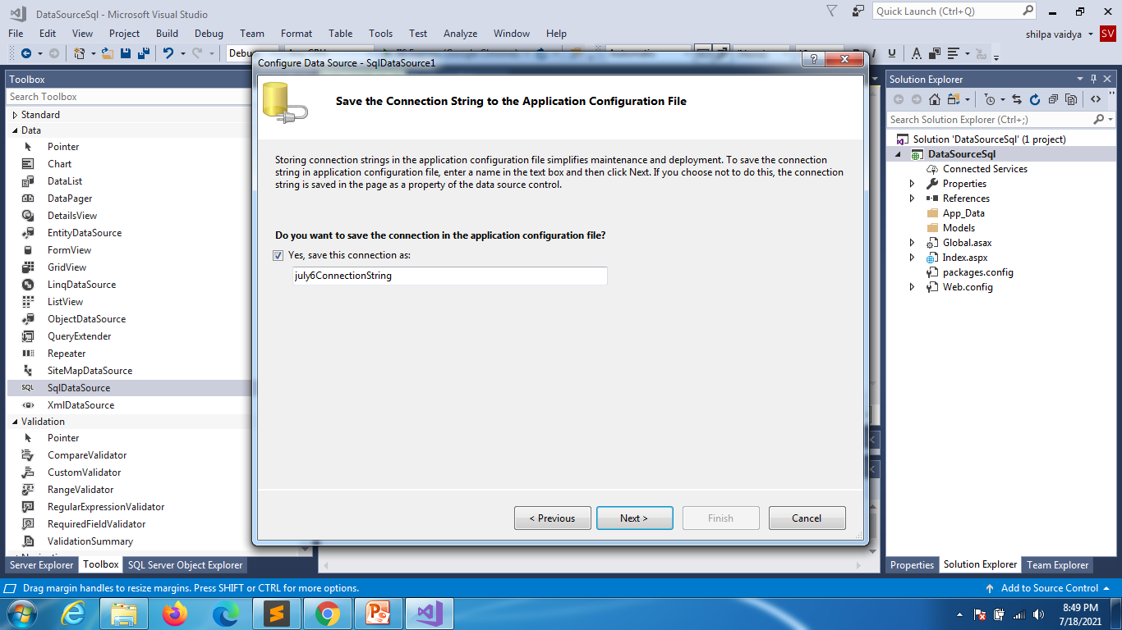

Slide 33
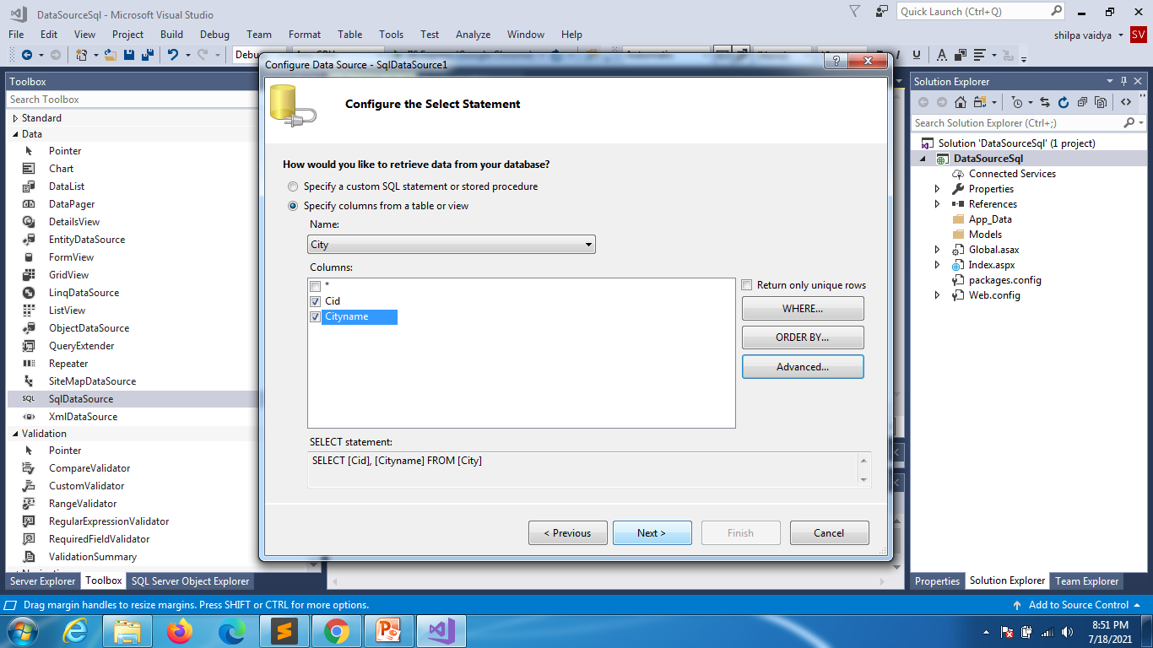

Slide 34
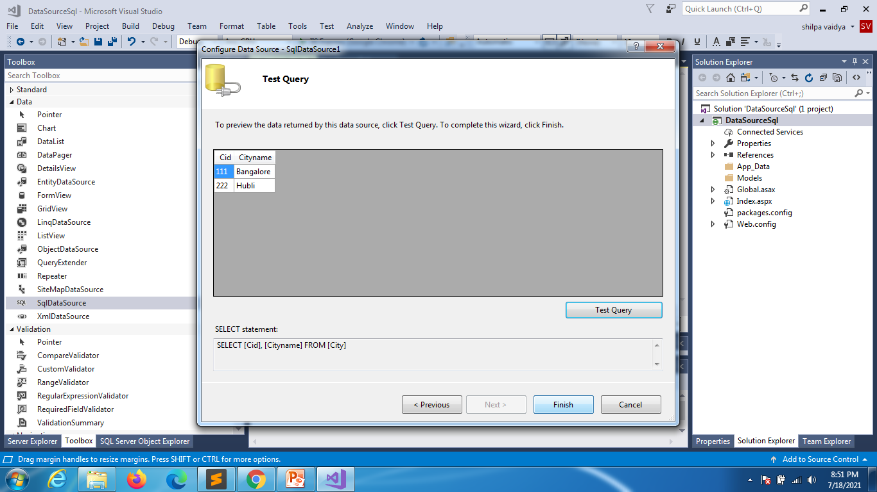

Slide 35
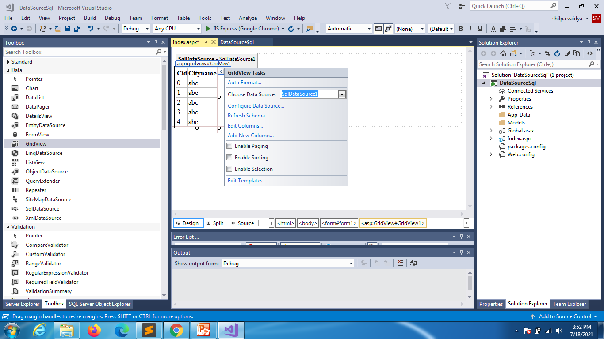

Slide 36
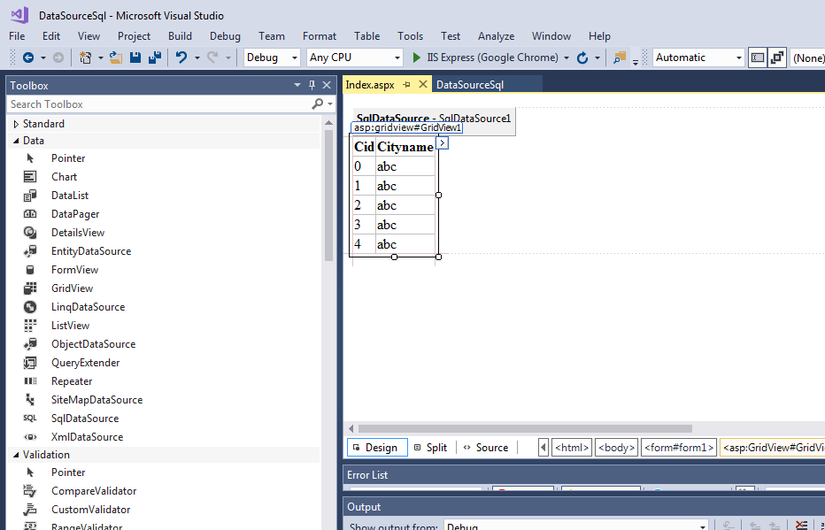

Slide 37
xml

Slide 38
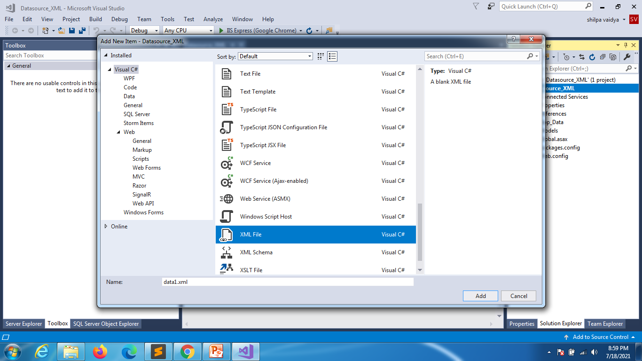

Slide 39
<?xml version="1.0" encoding="utf-8" ?>
<july6>
<City Cid="1111" Cityname="Hubli" />
<City Cid="2222" Cityname="Sirsi" />
<City Cid="3333" Cityname="Mysore" />
<City Cid="4444" Cityname="Karwar" />
</july6>

Slide 40
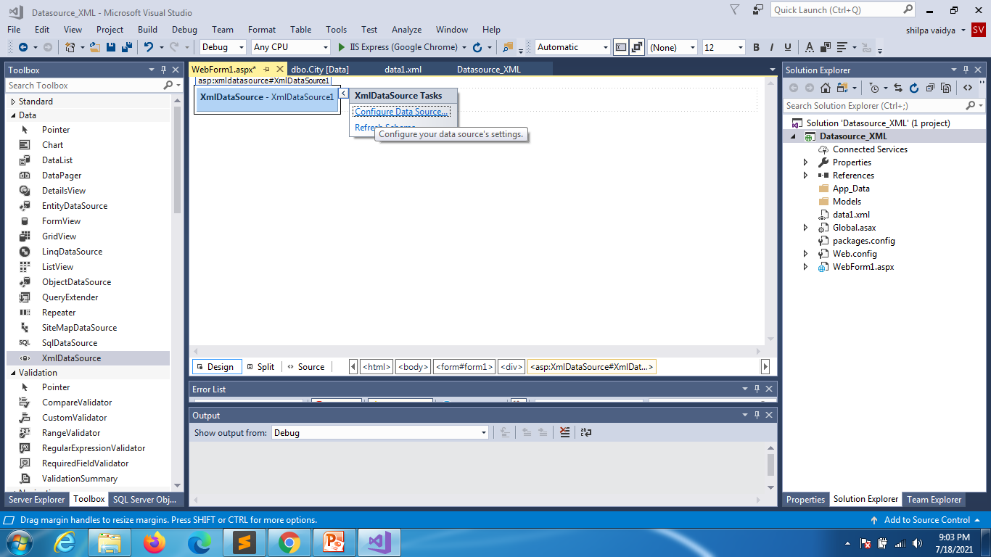

Slide 41
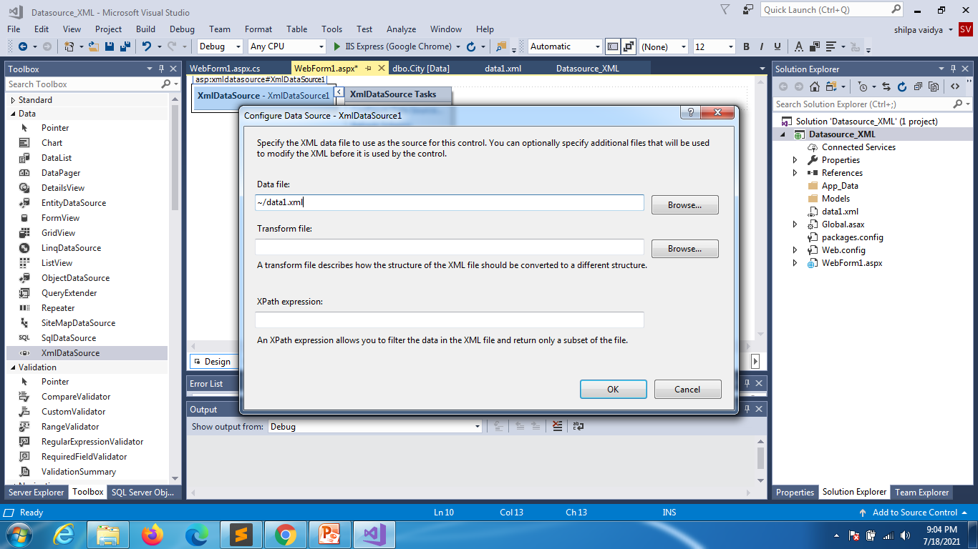

Slide 42
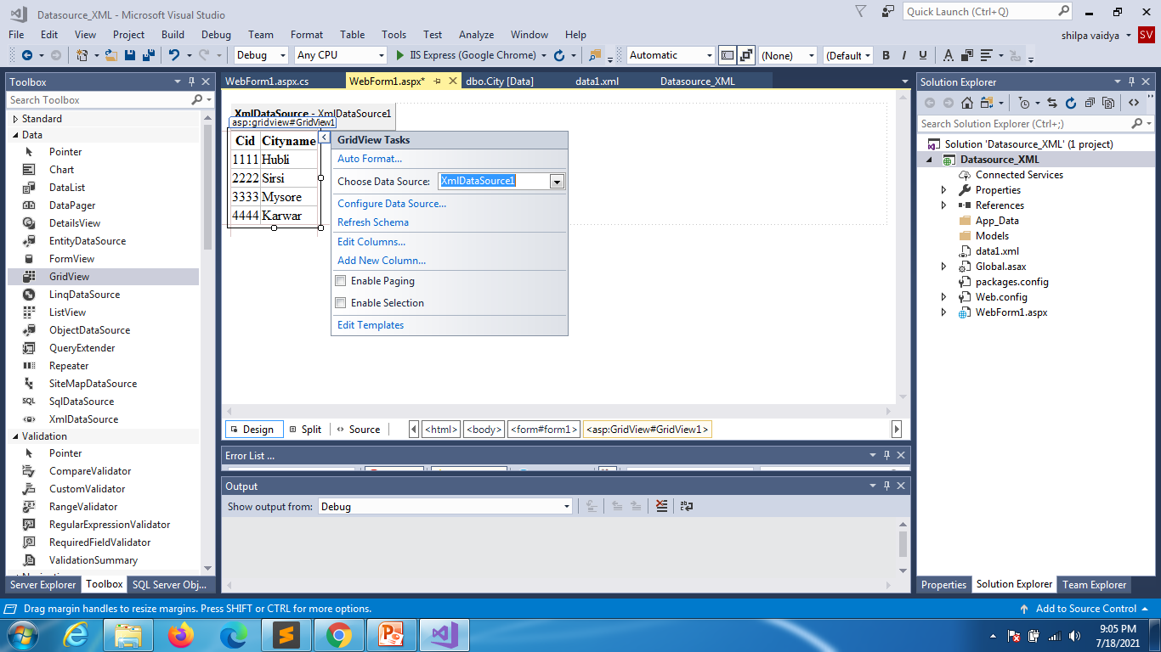

Slide 43
Another way : data2.xml
<?xml version="1.0" encoding="utf-8" ?>
<july6>
<City>
<Cid>5555</Cid>
<Cityname>Jharkand</Cityname>
</City>
<City>
<Cid>6666</Cid>
<Cityname>Jharkand</Cityname>
</City>
</july6>

Slide 44
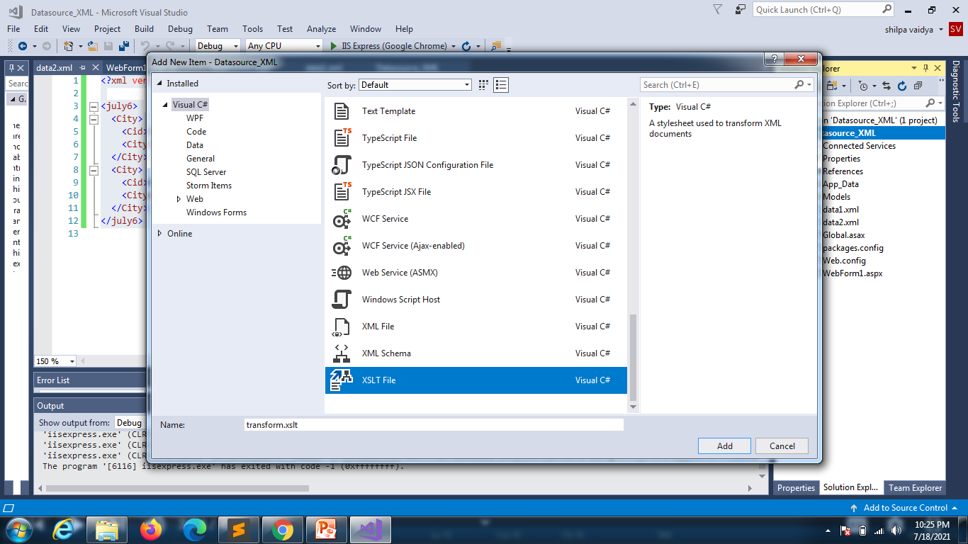

Slide 45
<?xml version="1.0" encoding="utf-8"?>
<xsl:stylesheet version="1.0" xmlns:xsl="http://www.w3.org/1999/XSL/Transform"
xmlns:msxsl="urn:schemas-microsoft-com:xslt" exclude-result-prefixes="msxsl">
<xsl:output method="xml" indent="yes"/>
<xsl:template match="july6">
<july6>
<xsl:apply-templates></xsl:apply-templates>
</july6>
</xsl:template>
<xsl:template match="City">
<City>
<xsl:for-each select="*">
<xsl:attribute name="{name()}">
<xsl:value-of select="text()"/>
</xsl:attribute>
</xsl:for-each>
</City>
</xsl:template>
</xsl:stylesheet>

Slide 46
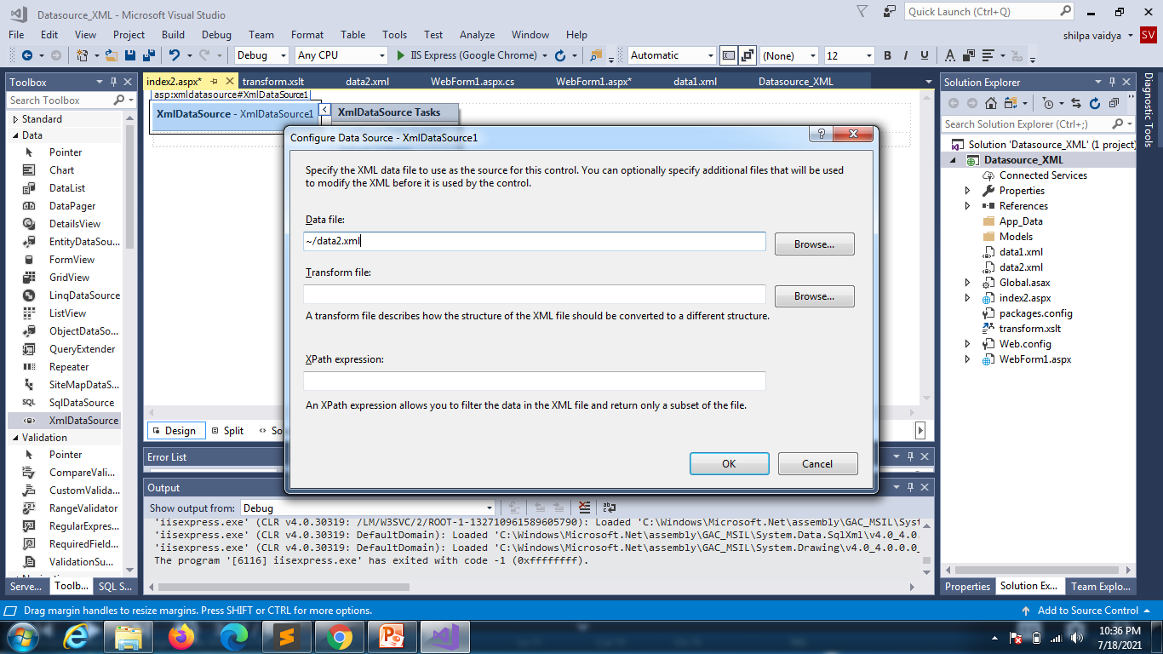
Click browse

Slide 47
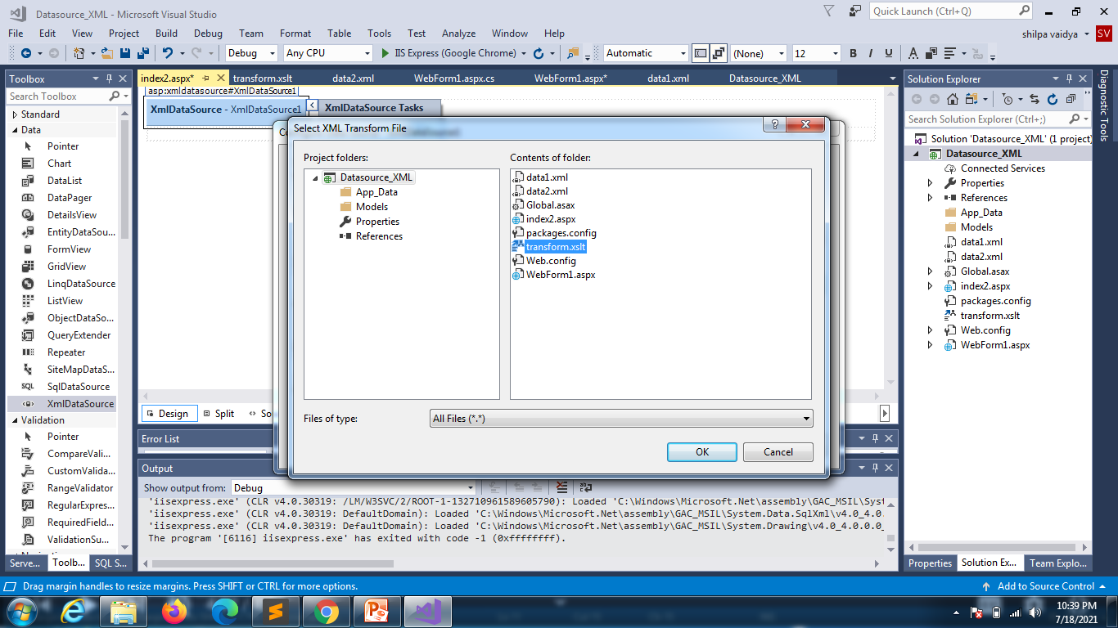

Slide 49
